Slide 1
Station Plot and Instrumentation Review
AOSC200 – 0201, 0103
TA: Hannah Daley
atmos.umd.edu/~hmdaley/AOSC200/

Slide 2
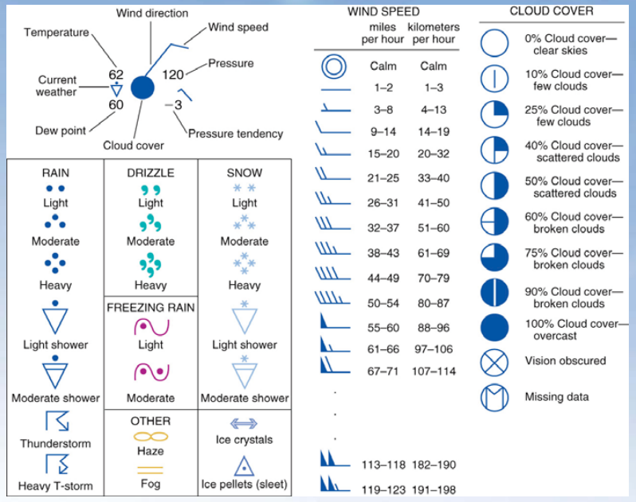
Weather Station Model
For quizzes and Exams you should know:
Dew point ≤ Temp
100% relative humidity: Dew Point=Temp
General sense of fastest wind speeds
General sense of cloud coverage
DO NOT MEMORIZE CURRENT WEATHER
Determine atmospheric pressure in 3 easy steps:
Move the decimal once to the left 120→12.0
If value is less than 50, add 10 to the front 12.0→1012.0 mbar
If value is greater than 50, add 9 to front

Slide 3
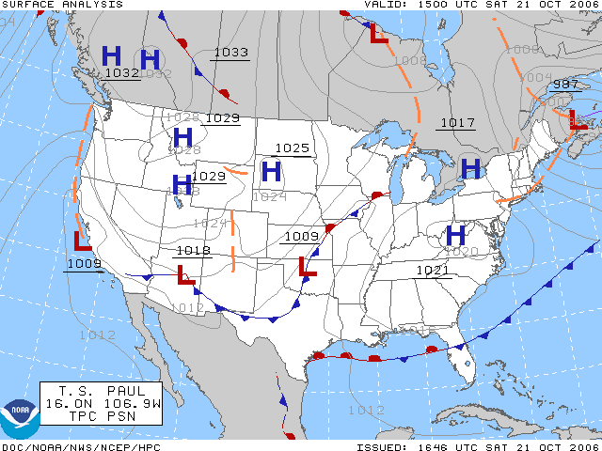
Weather Map Basics- Surface Pressure Types
High Pressure (H):
Associated with stagnant and hot conditions
Low Pressure (L):
Associated with fronts and stormy conditions
Extreme Low Pressure Conditions:
Heavy rain, strong winds, storm surge and flooding

Slide 4
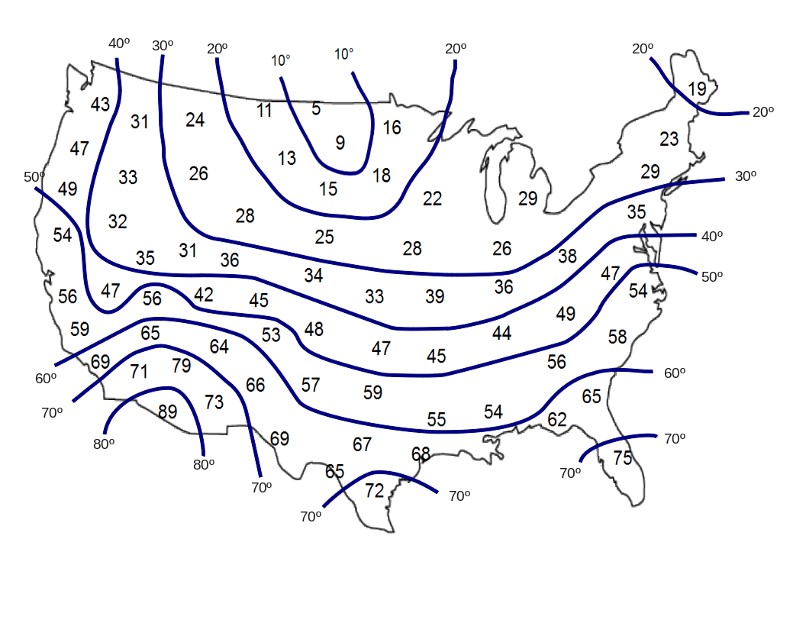
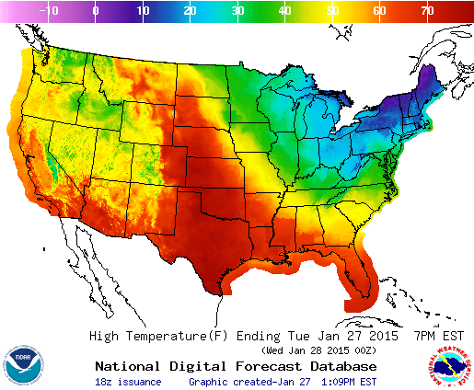
Weather Map Basics- Plotting Isotherms
Isotherm: A line of constant temperature

